Slide 1
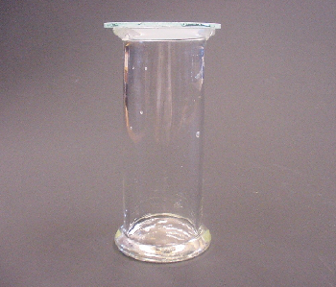
A particle model for the gas state (1/2)
1 This gas jar contains carbon dioxide at room
temperature.
It is in the gas state.
Which of A, B, C or D best describes it?
It is made of particles which are ‘gassy’ - like tiny puffs of gas.
There are particles dotted about in the carbon dioxide.
It is made of particles which are not like little puffs of carbon dioxide gas.
It does not have any particles.

Slide 2
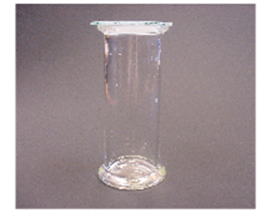
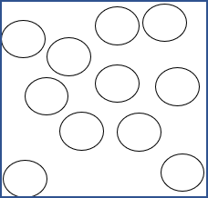
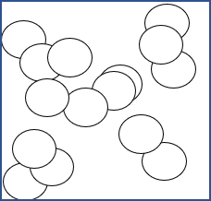
A particle model for the gas state (2/2)
2 Imagine you could see the particles in this sample
of carbon dioxide.
Which diagram best matches what would you see?
A Particles not moving
B Particles moving freely
C Particles not moving
D Particles moving freely

